Slide 1
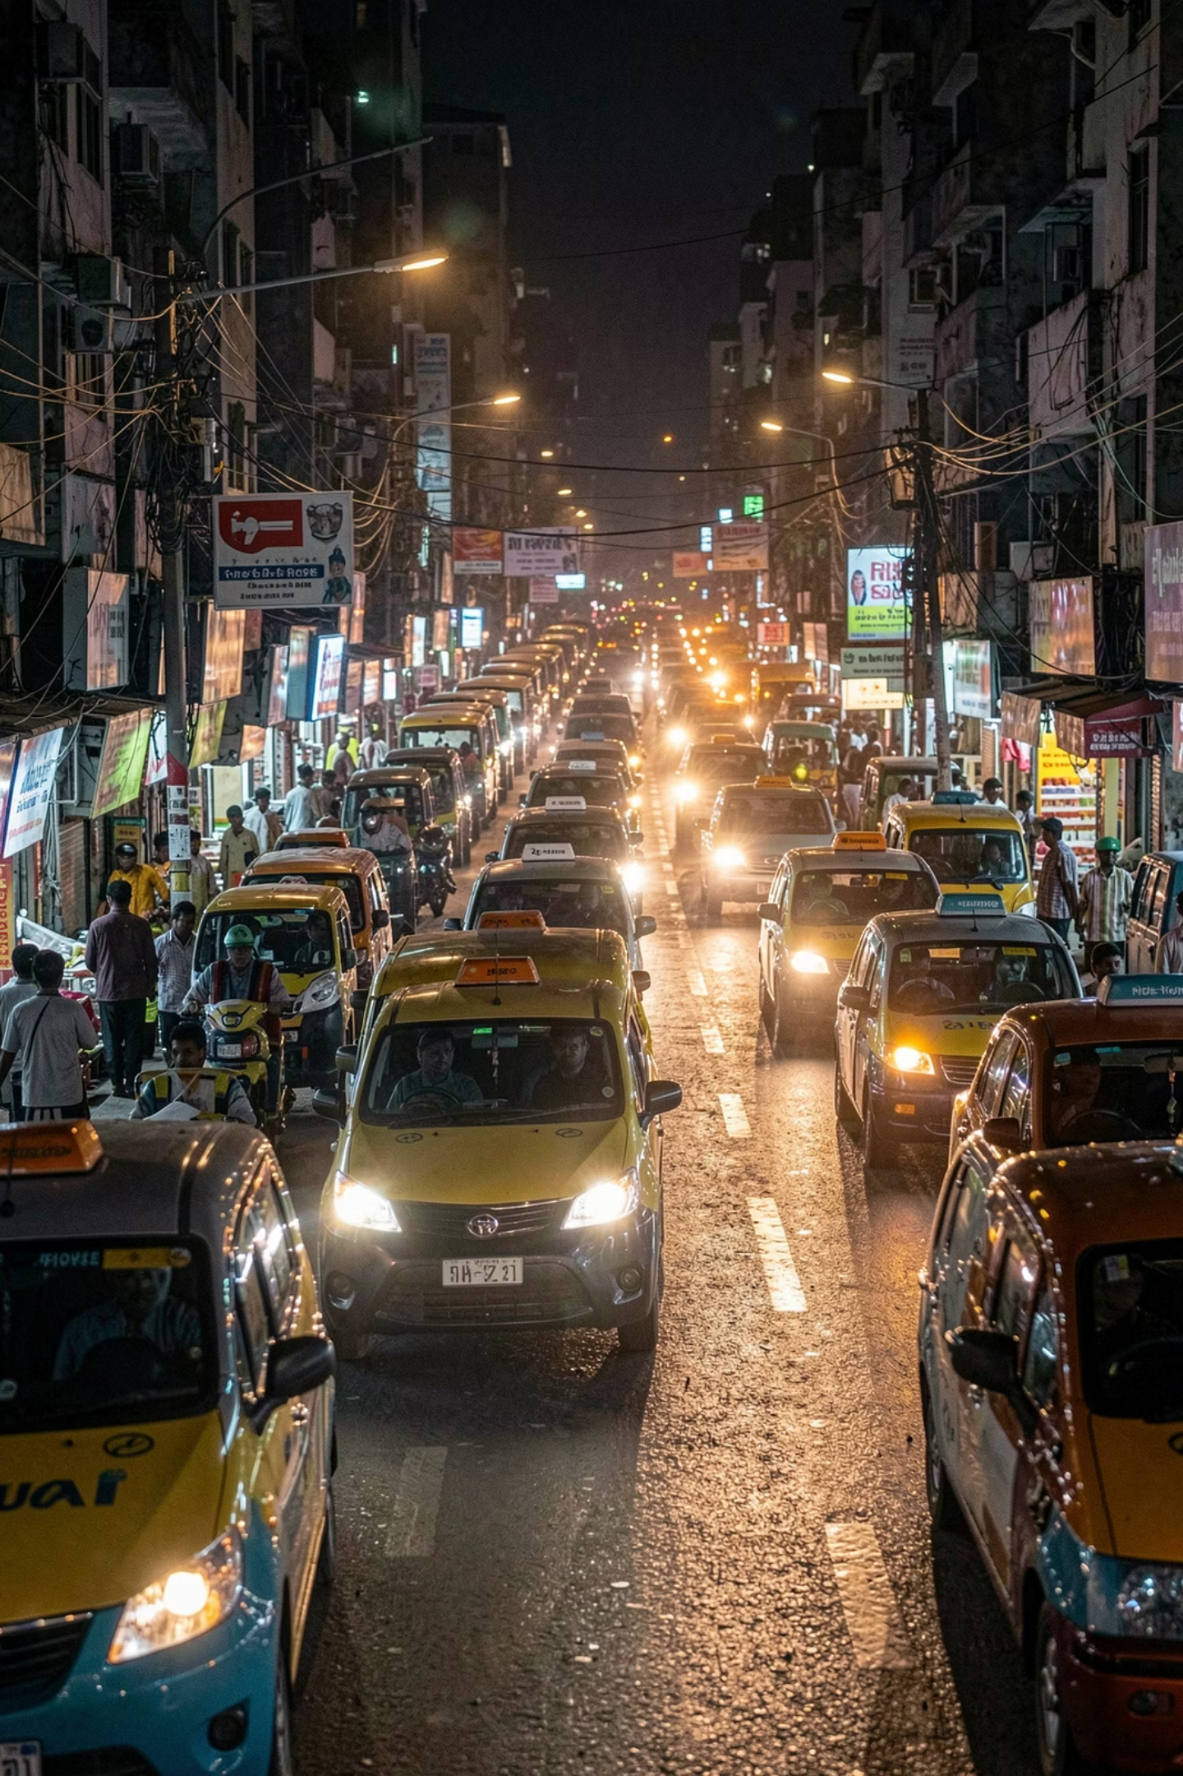
OLA Booking Data Analysis
May 2024 · 100,000 Records · Python · SQL · Power BI

Slide 2
Dataset at a Glance
100K
60,288
Total Records
Unique Customers
May 2024
7
5
Vehicle Types
Booking Statuses
Auto, Mini, Bike, E-Bike & more
Success, Cancelled, Incomplete…
16 columns · 50 pickup & 50 drop locations · Most common: Pisoli → Wanowrie

Slide 3


Python EDA Highlights
62,094 Successful Rides
Most frequent booking status
Auto: Most Booked
25,077 bookings in May
Avg VTAT ~8 min · CTAT ~6.5 min
NaN values only for non-successful rides

Slide 4
SQL Query Findings
#
Query
Finding
1
Successful Bookings
62,094 rides
2
Avg Ride Distance
~18 km across all vehicle types
3
Customer Cancellations
~6,872 rides
4
Top Customer Rides
Max 7 rides in May
5
Driver Cancellation Reason
Personal & Car issues (#1)
6
Prime Sedan Ratings
Max 5.0 · Min 1.0
9
Total Booking Value
~32.42M INR (successful)

Slide 5
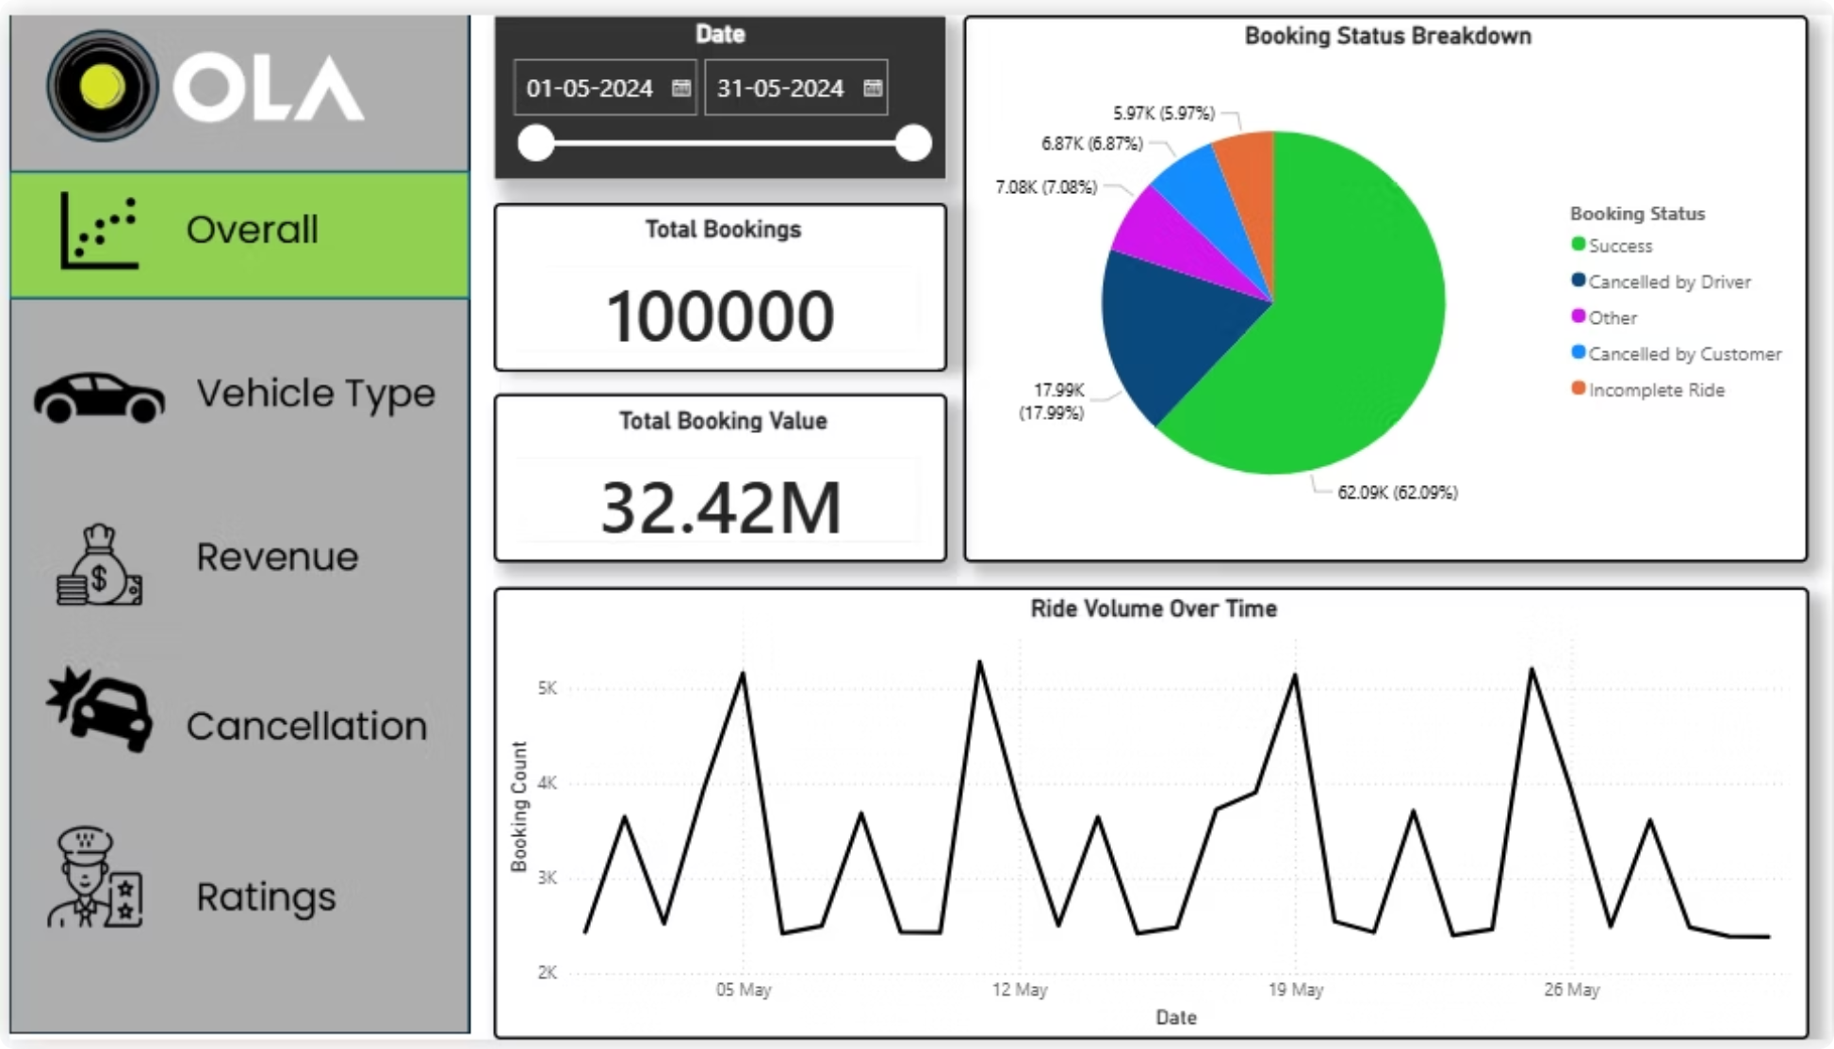
Power BI Dashboard — Overall
62.09%
17.99%
Success rate
Cancelled by Driver
6.87%
5.97%
Cancelled by Customer
Incomplete Rides

Slide 6
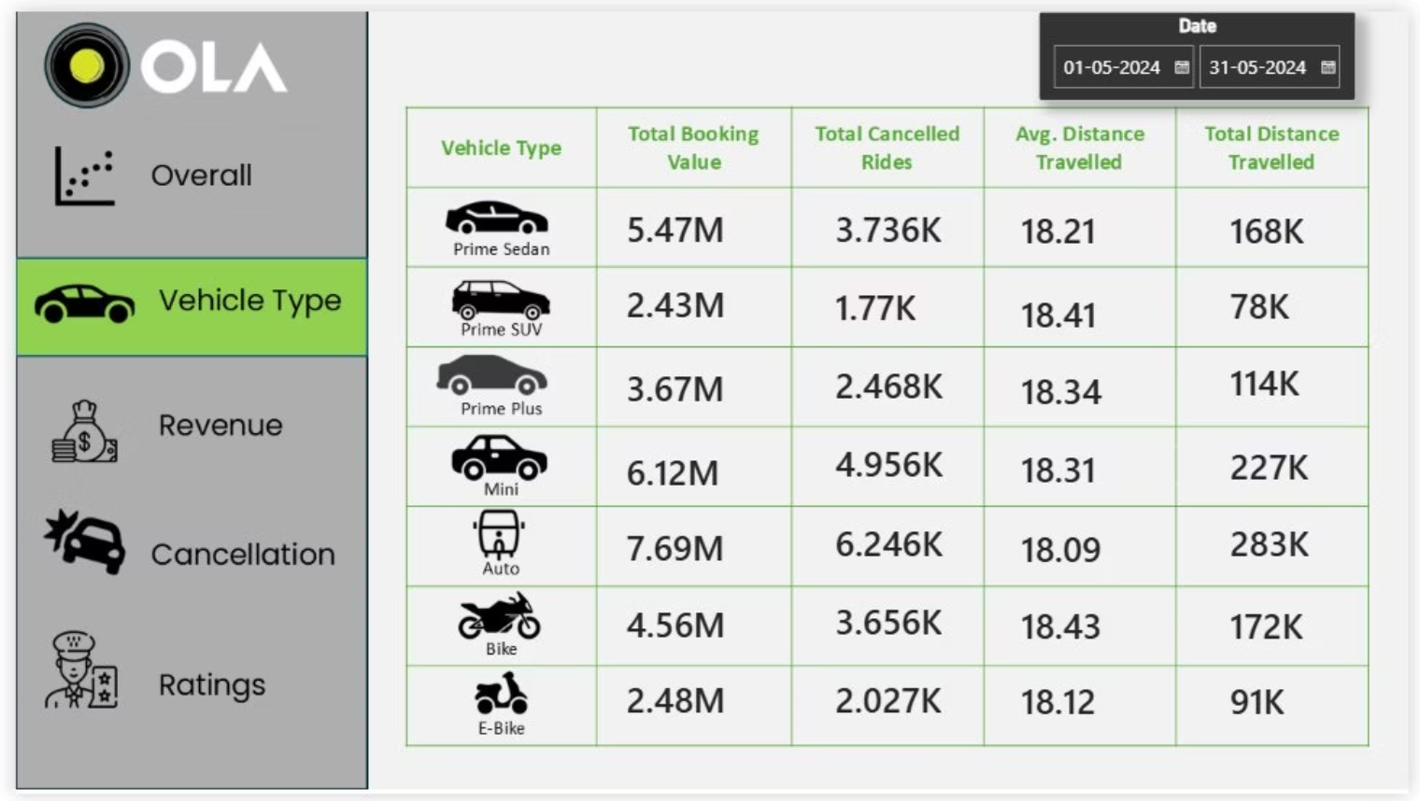
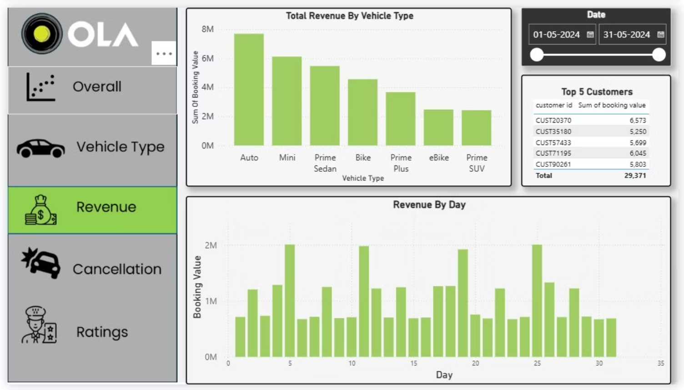
Power BI Dashboard — Vehicle Type & Revenue
Auto leads revenue at 7.69M INR · Mini second at 6.12M · All types avg ~18 km/ride

Slide 7
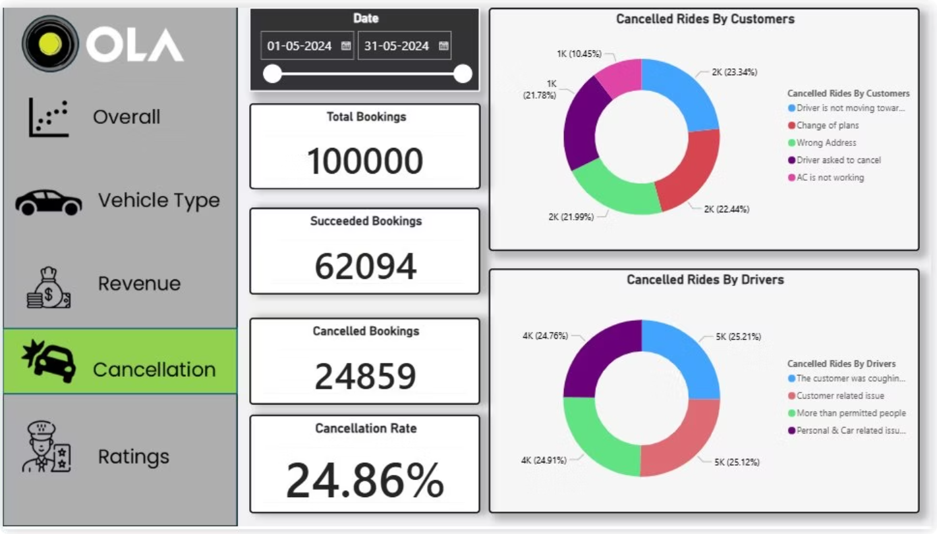
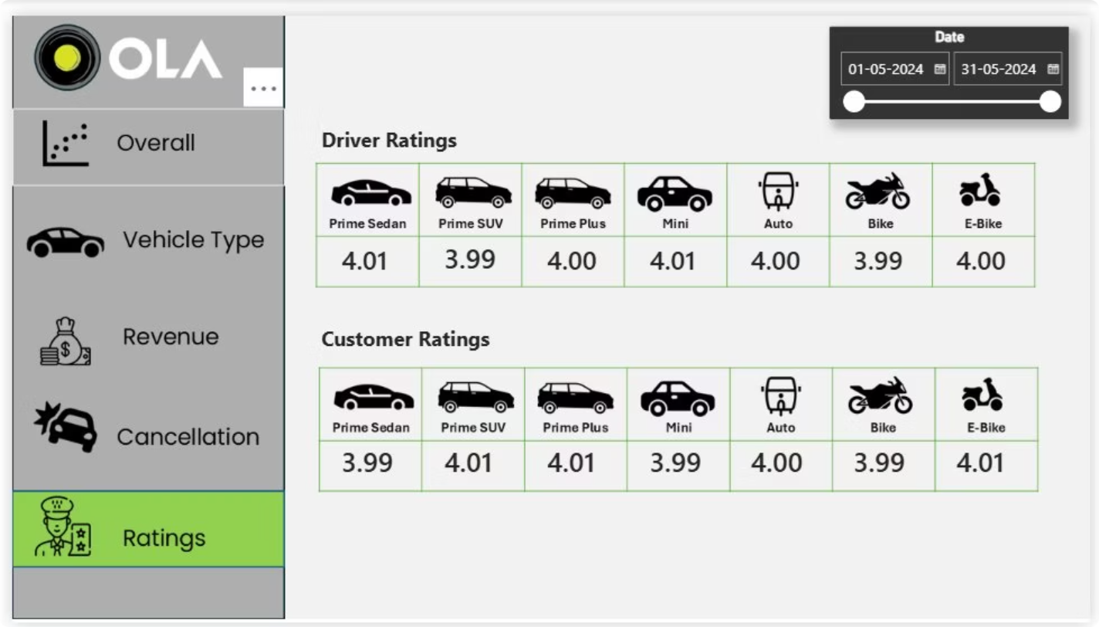
Power BI Dashboard — Cancellations & Ratings
24.86% Cancellation Rate
~4.0 Ratings Across All Types
Top customer reason: driver not moving to pickup (23.34%)
Stable service quality platform-wide (3.99–4.01)

Slide 8
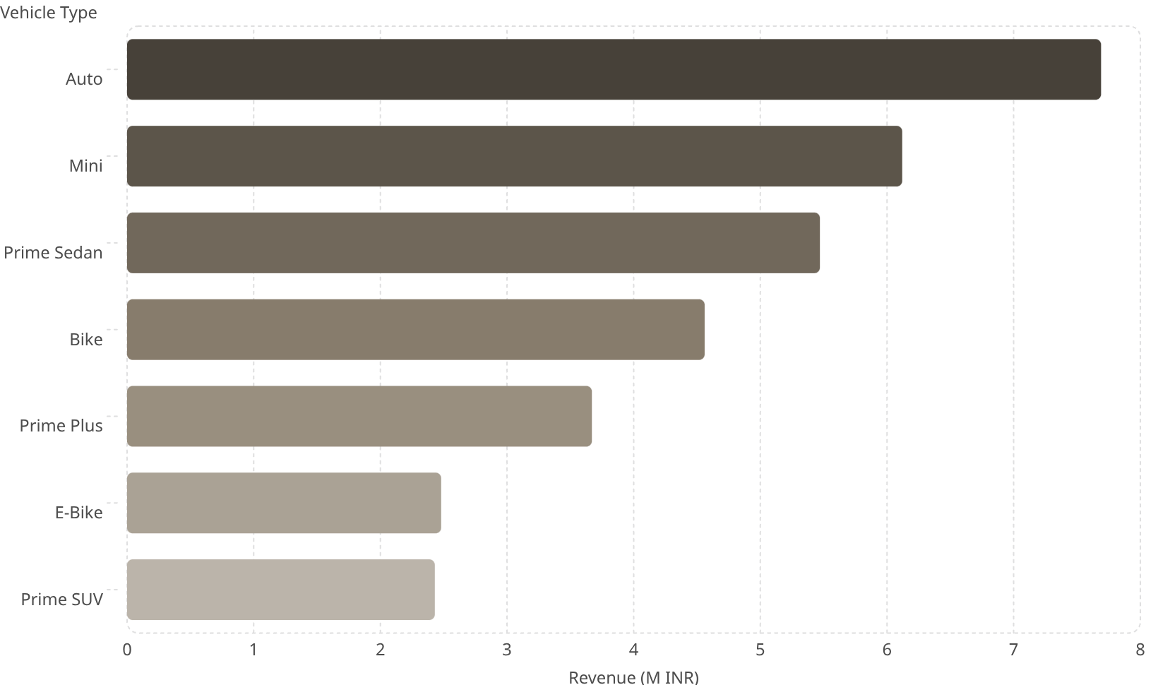

Revenue by Vehicle Type
Total: 32.42M INR
7.69
Auto dominates with highest bookings and highest revenue — driven by sheer demand volume.
6.12
5.47
4.56
Prime SUV & E-Bike have the lowest booking values — prime targets for promotional campaigns.
3.67
2.48
2.43

Slide 9
Key Findings
Auto Dominates
62.09% Success Rate
Most booked · Highest revenue (7.69M INR) · Highest cancellations (6,246)
62,094 rides completed · 32.42M INR total value
24.86% Cancellations
Stable ~4.0 Ratings
Driver-side issues are primary cause
Consistent across all 7 vehicle types

Slide 10
Business Recommendations
01
02
03
Fix Driver Cancellations
Improve GPS Navigation
Scale Auto & Mini Fleets
Stricter policies + vehicle maintenance checks
Reduce #1 complaint: driver not moving to pickup
Deploy more during peak hours to maximize revenue
04
05
Reward Loyal Customers
Promote Prime SUV & E-Bike
Loyalty discounts for top customers (e.g. CUST20370)
Targeted discounts to boost low-demand segments

